Slide 1
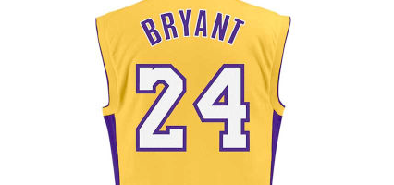
Kobe Bryan Shot Prediction
DS6372: Project 2
Joe Schueder, Anthony Egbuniwe, Che Cobb

Slide 2
Agenda
Introduction
Motivation and Goal
Dataset and Data Collection Process
Exploratory Data Analysis
Full Model Analysis
Distance
Conclusions

Slide 3
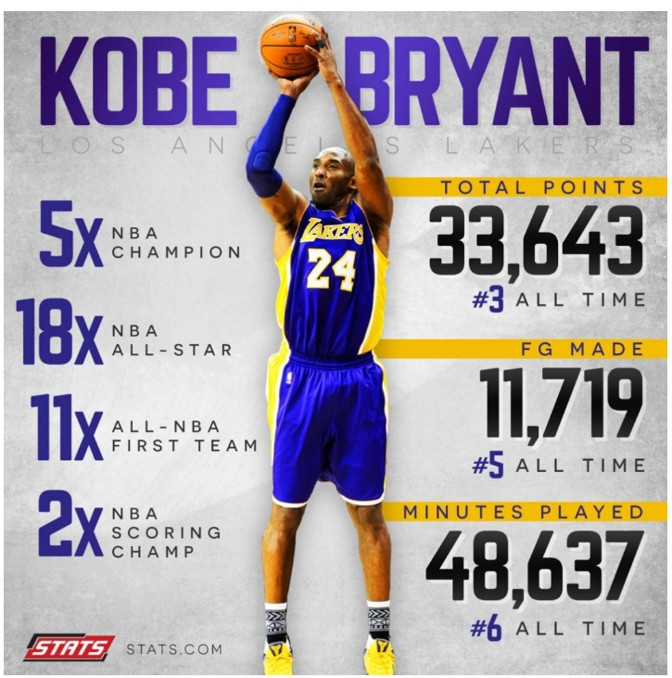
Introduction
The career of Kobe Bryant
Kobe Bryant marked his retirement from the NBA by scoring 60 points in his final game as a Los Angeles Laker in 2016.
Using 2014- 2016 data as a retrospective study of Kobe's
swishes and misses, predictive models were built for Kobe Bryant’s shots with Logistic Regression techniques.
The goals was to find the most significant features in predicting his shots (shot_made_flag). The target variable for this project is binary, with 0-missed, 1-made.
The objective is to predict Kobe’s shots with Logistic Regression models and compare the models’ performance.

Slide 4
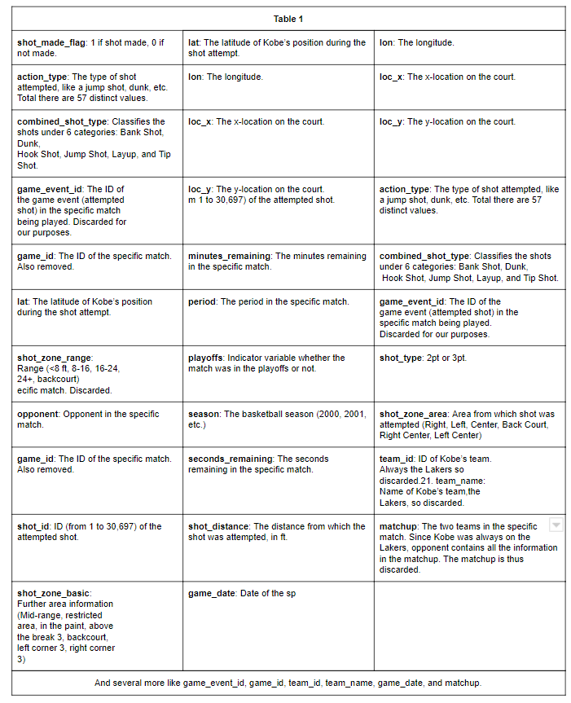
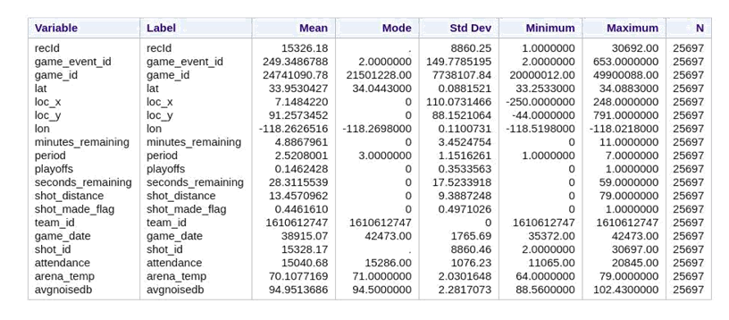
Dataset and Collection Process
This dataset is created for prediction of Kobe Bryant shot selection and the dataset link is below:
https://www.kaggle.com/c/kobe-bryant-shot-selection
The dataset, obtained from Kaggle, was sourced directly from the NBA. It contains every goal attempted by Kobe in his 20-year career, a total of 30,697 shots. Of these, 5,000 were randomly selected to serve as a test set in file project2pred.xlsx, with their shot success labels removed. The data contains many pieces of information, with 25 variables in total. The table (Table 1) shows all the variables and their disposition.

Slide 5

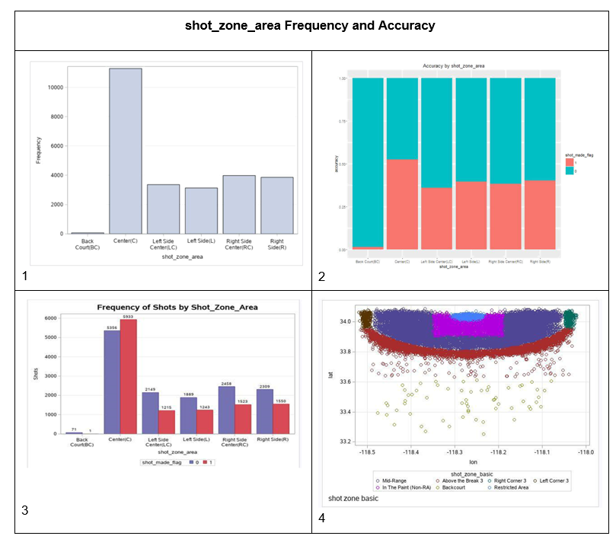
Exploratory Data Analysis | Output Variables
Need for transformations
Missing Values
Outliers
Statistical Behavior
Multi-collinearity

Slide 6
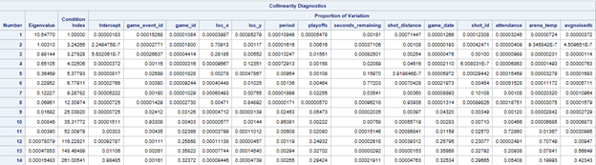
Exploratory Data Analysis | Multi-collinearity
Multicollinearity is a state of very high inter-correlations or inter-associations among the independent variables. It is, therefore, a type of disturbance in the data, if present in the data the statistical inferences made about the data may not be reliable.
In review of the eigenvalue and condition index association, there is a large deviation in the final three factors, with the eigenvalue resulting very close to zero and the condition index resulting quite large in comparison. So, a prime case for multicollinearity was found.

Slide 7
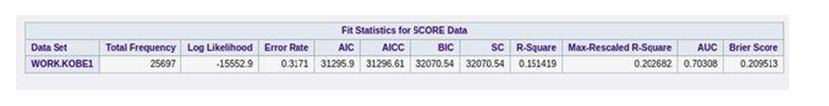
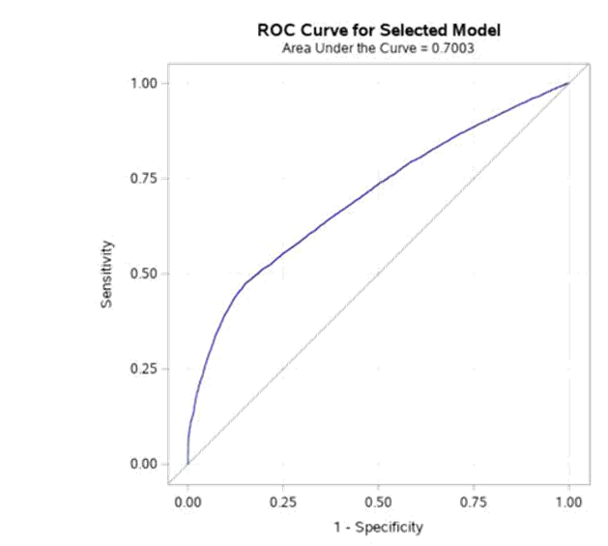
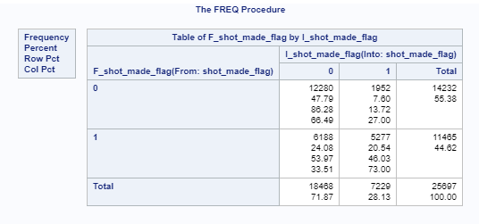
Best Model? |
The AUC value for this model is 0.7030 i.e. 70% accuracy. It can be observed that the effect on prediction error increase as the model grows more complex
Overall Misclassification Rate is 8,140/25,697 = 31.7%.
Sensitivity is estimated to be 12,280/14,232 = 86.3% from this study.
Specificity is 5,277/11,465 = is 46%.

Slide 8
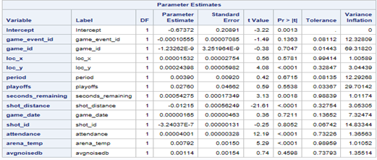
Best Model | Variables, Coefficients, Confidence Intervals
LASSO Regression and correlation of variable methods were used to select the set of the final variables for the operations like model fitting and prediction. All variables were statistically significant at the 0.05 level.

Slide 9
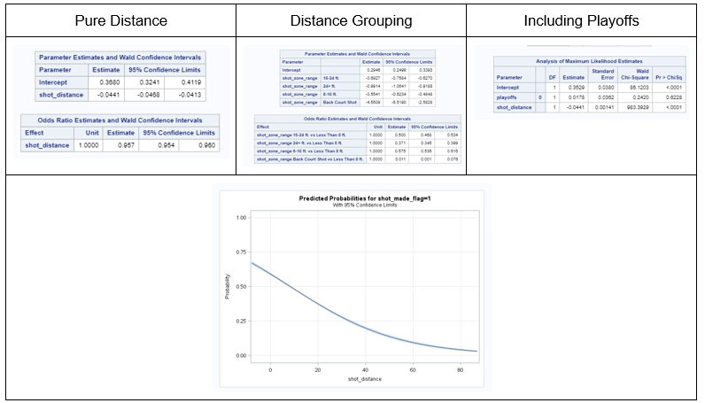
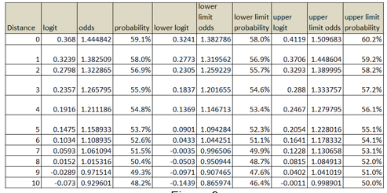
Distance Aalysis| The largest factor
One of the most significant variables in determining whether Kobe will make a shot is the distance from the hoop. The analysis of this specific variable shows that as the distance from the hoop increases the probability of making the shot decreases. As shown in various images in figure 8 the probability of making a shot goes from around 55% at zero feet to close to 0% at 80 feet in a non-linear pattern. There are not significantly different odds and probabilities between the regular season and playoffs.
In simpler odds and probability terms, each foot further away from the goal decreases the probability by 1.1% based on converting logit to probability. A sampling of distances and probabilities with confidence intervals are shown

Slide 10
Best Model | Inference and Conclusion
To evaluate this model, the predictions were performed on a test set of data. Using the Log loss metric, the performance of this model was compared. The Log Loss value for this model is about 11.182. Unfortunately, performance is not as high as desired.
Still, the work presented here goes a long way in showing how applicable modern statistics is to sports
Team coaches can easily maintain a model for each of their players
analyze which shots they need to improve on and which they excel
whether their performance dips with less time remaining in the match
who on the team should shoot longer ranges
where to position each player
The possibilities are endless. Hopefully, this exercise will serve as a step towards more creative quantitative analysis in sports.

Slide 11
Model Improvement Recommendations
Classification
Cluster Analysis
Decision Trees

